Slide 1
Unit-2
Deep Learning

Slide 2
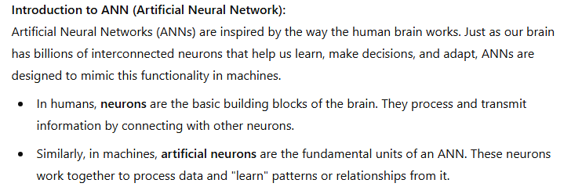
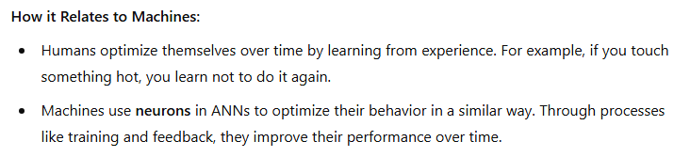
Introduction to CNNs

Slide 3
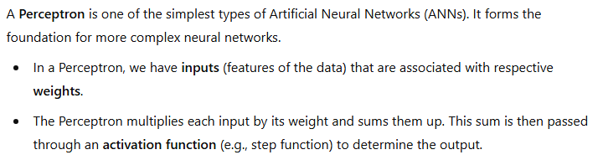
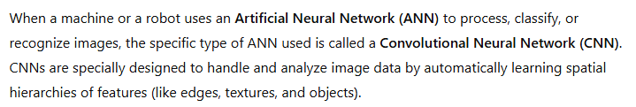
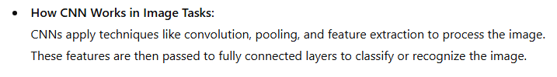

Slide 4
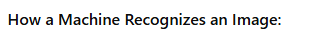
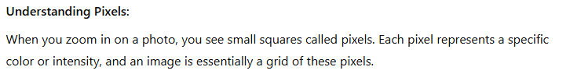
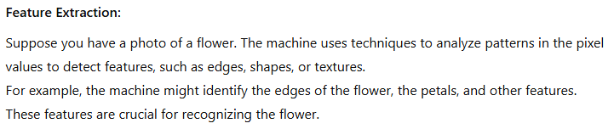
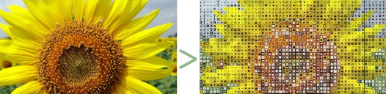
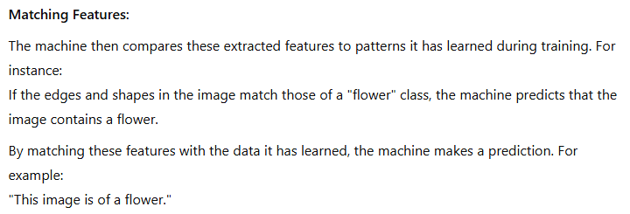

Slide 5
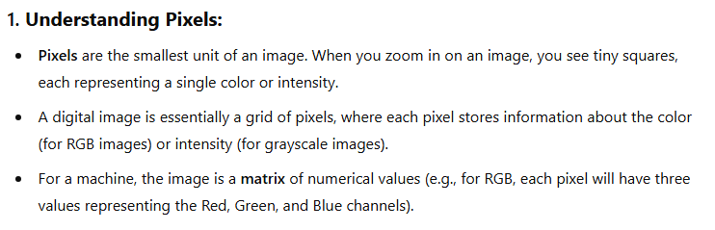
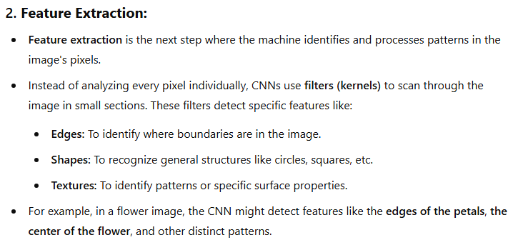
Lets, see the working flow of CNN based on the image of the flower:-

Slide 6
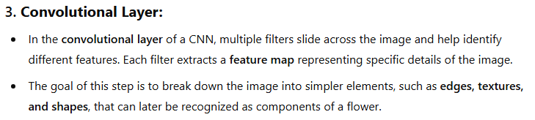
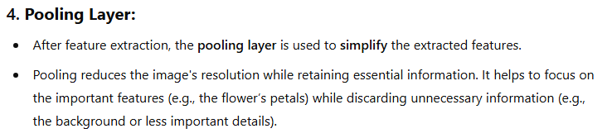

Slide 7
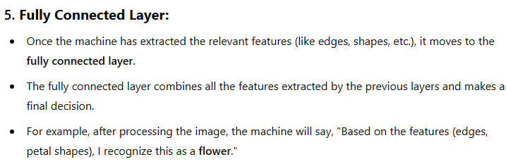
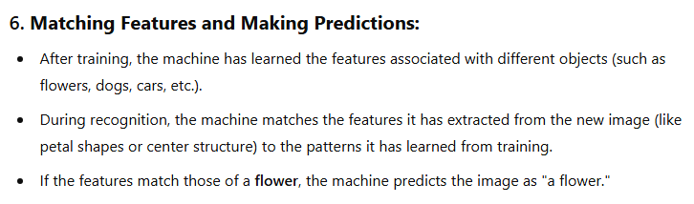

Slide 8
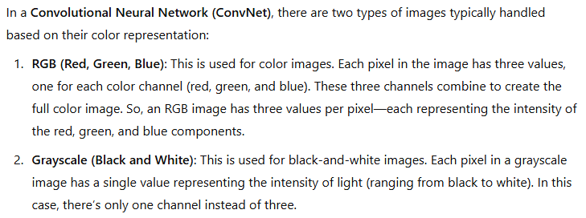
Another name of Convolutional Neural Network is ConvNet.

Slide 9
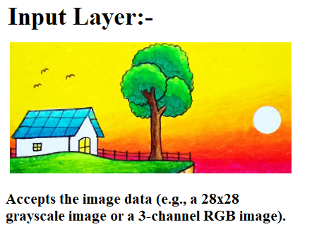
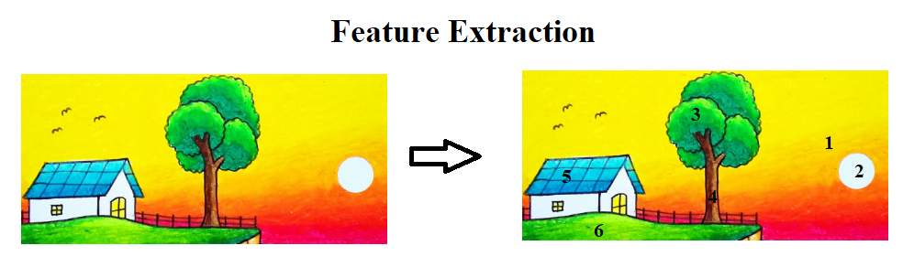
Working flow of CNN in pictorial representation:-

Slide 10
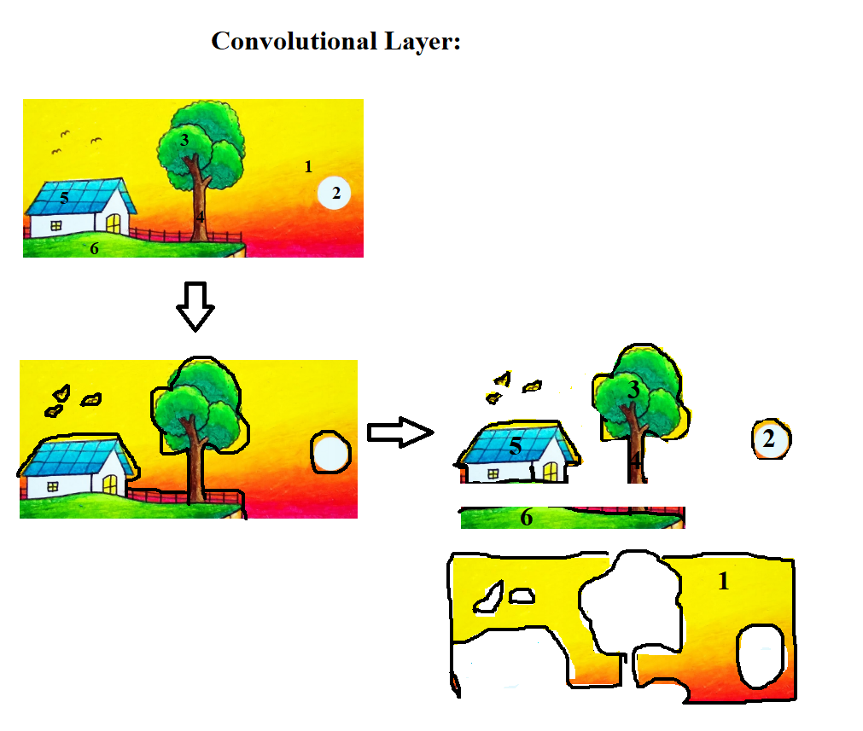

Slide 11
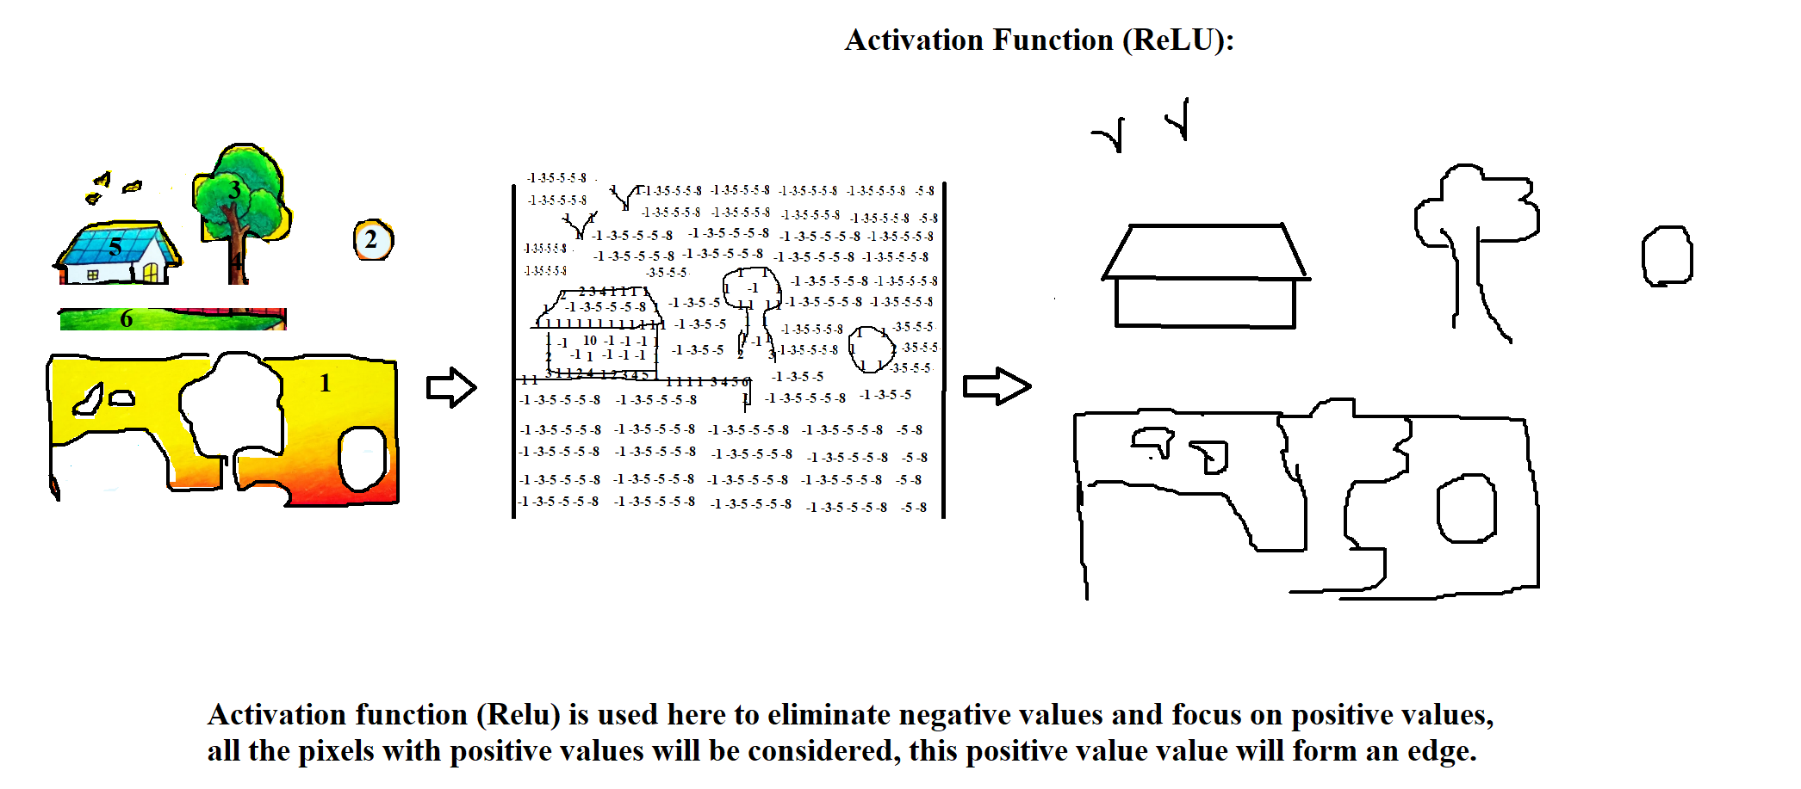

Slide 12
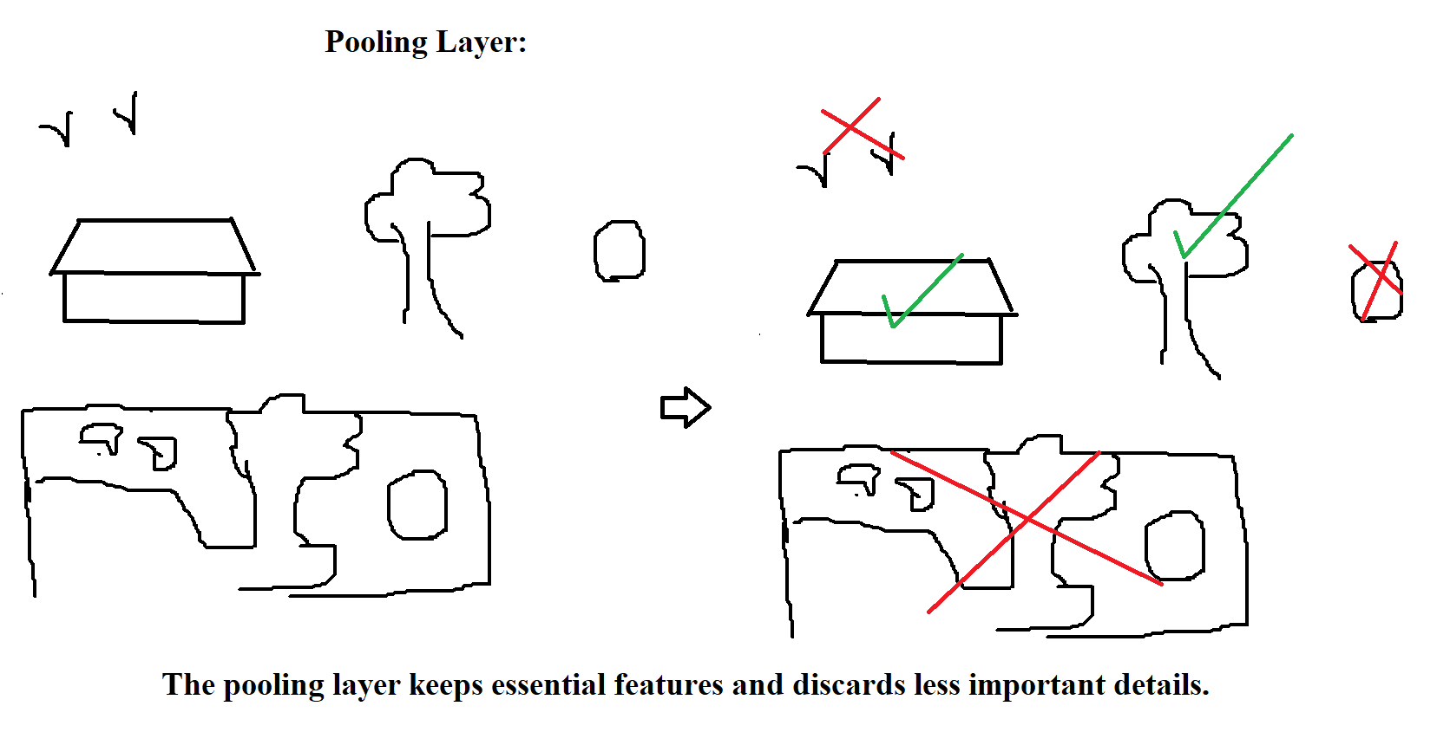

Slide 13
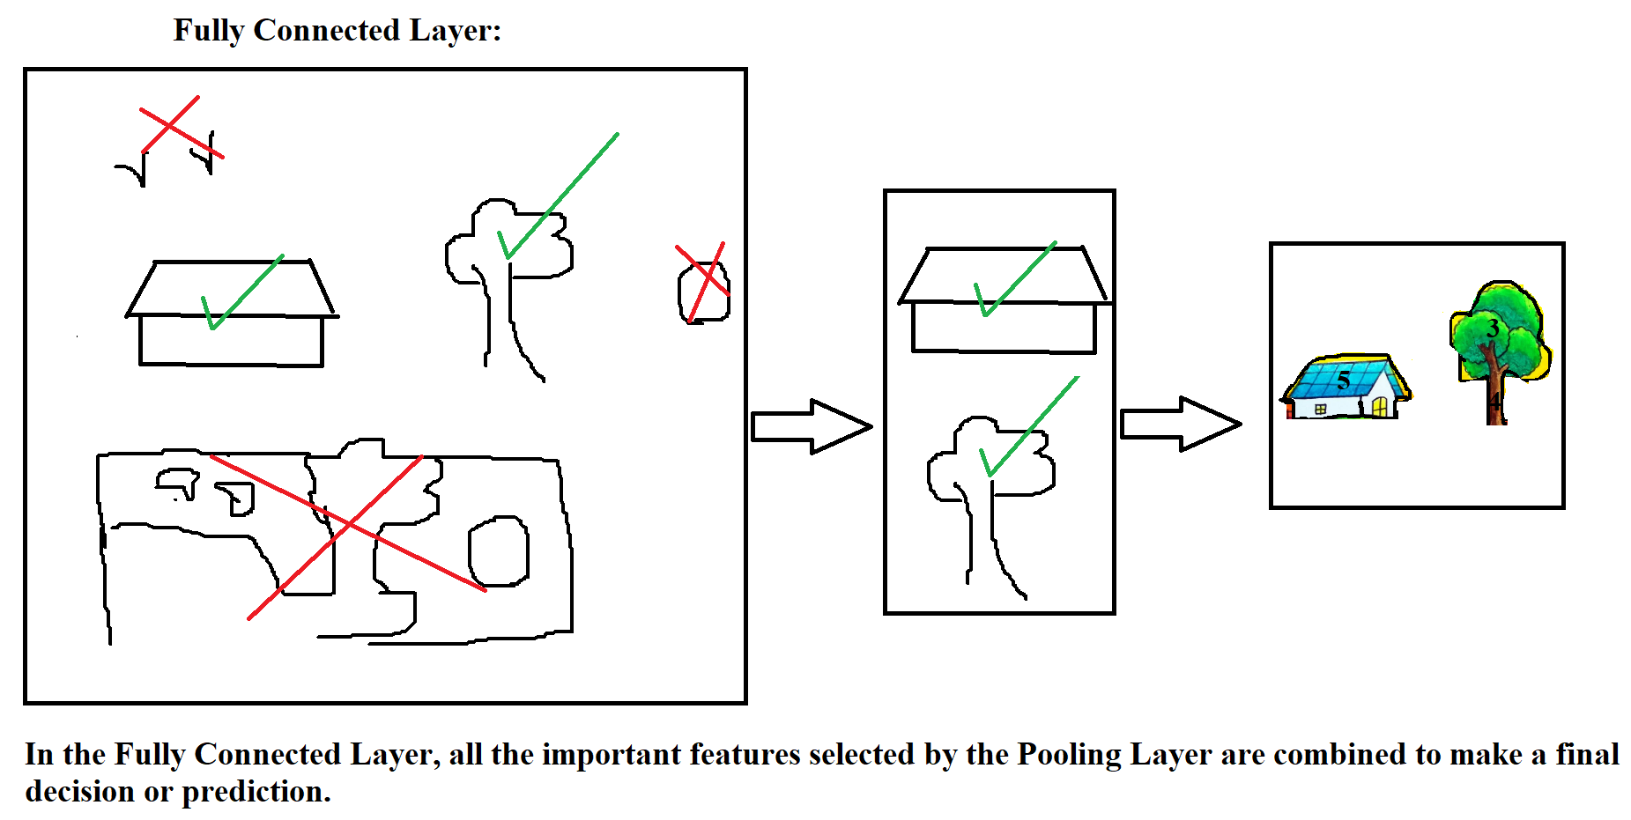

Slide 14
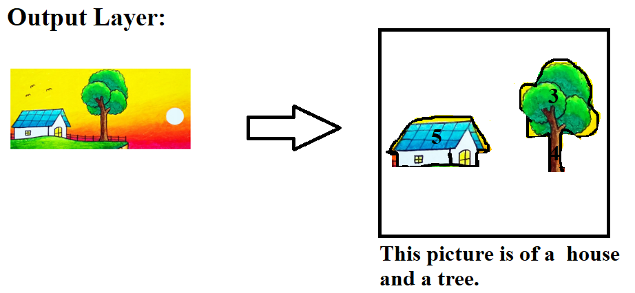
Now, suppose I want to see the output in probability format, then in that case, I will be using an activation function before output. Since I am dealing with house and tree simultaneously, in that case, I will be using softmax. If I am only dealing with a house or tree, then I will be using sigmoid, but in this case, I am dealing with a house and tree, because house and tree are both important feature. So, I will be using softmax here.

Slide 15
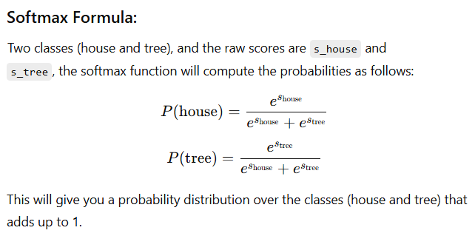
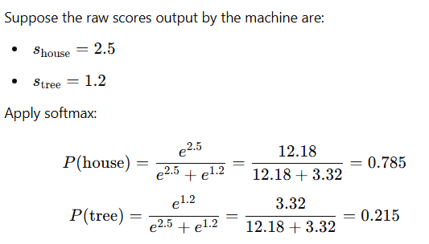
Here, the machine will automatially calculate the raw input of each feature. After that, it will use softmax formula to find the probabilities.

Slide 16
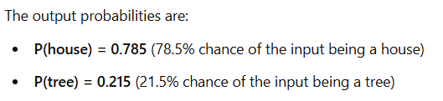
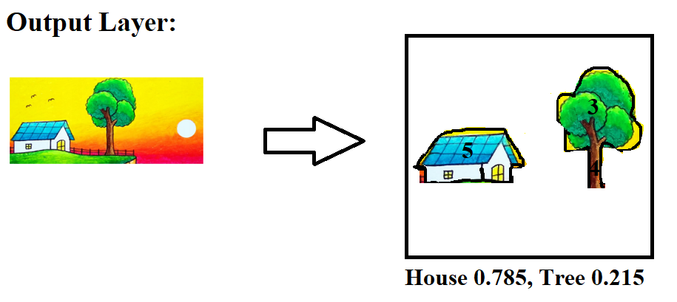

Slide 17
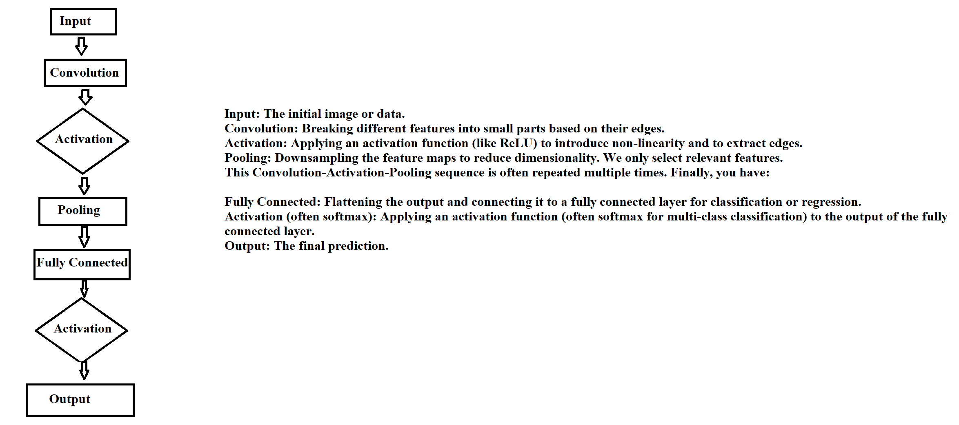

Slide 18
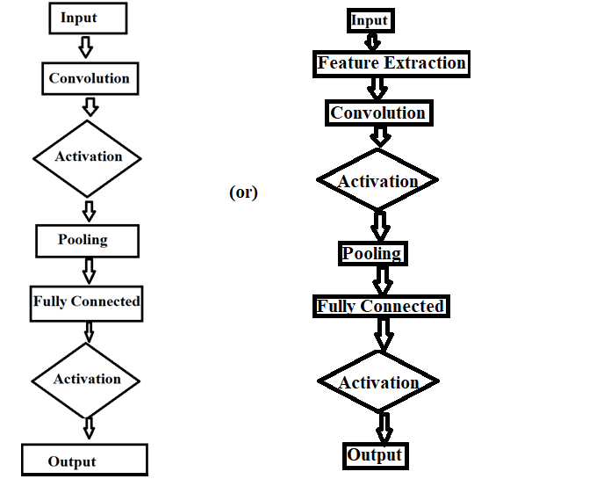
We can draw either of them, its upto us.

Slide 19
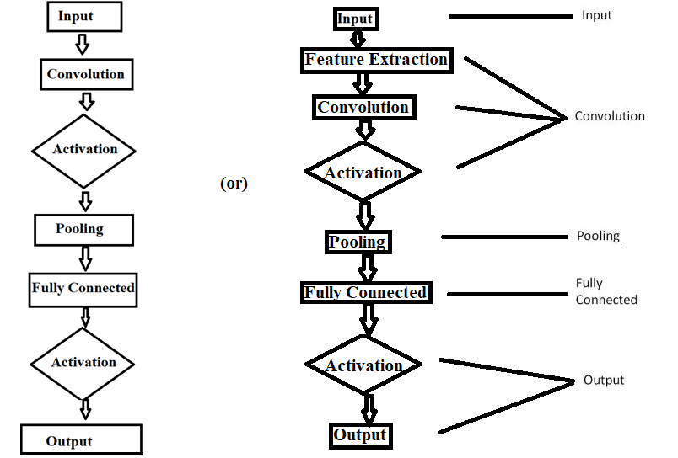

Slide 20
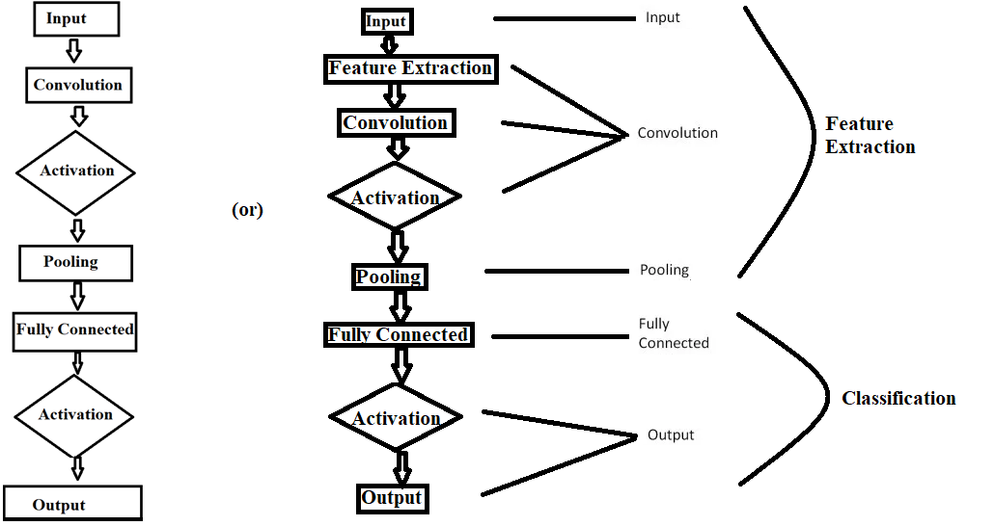

Slide 21
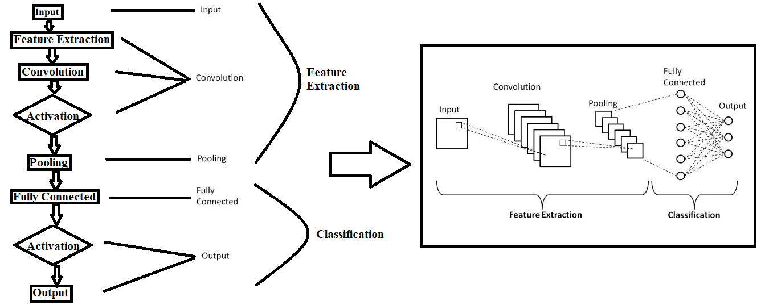
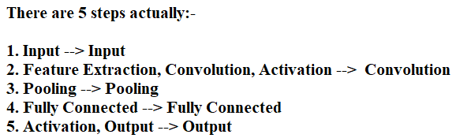

Slide 22

Now, lets go in more details:-
In the previous example, we discussed an image of a house and a tree with a background. Now, suppose I have an image of the digit '8' with no background, just the '8' itself. In this case, how will convolution break the image into smaller parts, and how will pooling select the relevant features?

Slide 23
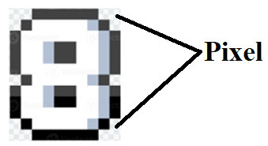
You have a plain image with the digit "8." Even though it’s a single object with no background, convolution and pooling still apply effectively. The goal here is to extract features from the shape and structure of the "8.“
Input:- First it will take the image as an input.
Convolution:-
The image is divided into smaller sections, called pixels, and each pixel has a value.

Slide 24
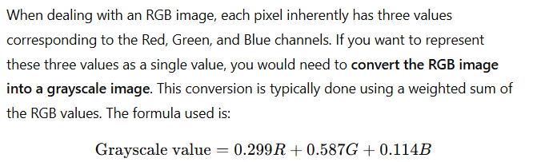
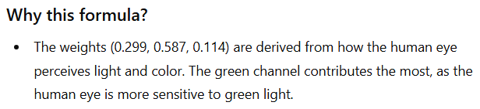
In grayscale images, each pixel has a single intensity value representing shades of gray, typically ranging from 0 (black) to 255 (white).
In colorful images, each pixel is represented by three values corresponding to the RGB channels (Red, Green, and Blue), each with its own intensity ranging from 0 to 255. These values combine to form the pixel's color.
How to combine these three values to form a single value:-

Slide 25
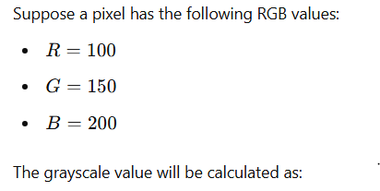
Since, we have a black white image, the values of pixel will remain same.

Slide 26
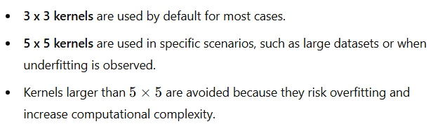
The CNN model will automatically compute the number in each pixel, if the model is dealing with colourful image, it will automatically generate the formula to convert three numbers into single number.
After getting all the numbers which are present in each pixel, it will automatically generate Kernel.
In a Convolutional Neural Network (CNN), the kernel values learned during the training process by the model only.
Initially, the kernel values (weights) are randomly initialized.
During training, these kernel weights are updated through backpropagation to minimize the error (loss) and better extract features from the input data.
Over time, the model "learns" the optimal kernel values that help identify relevant features such as edges, patterns, or other characteristics in the image.
For small images (like 3x3), use a 2x2 kernel to capture local features efficiently. For larger images, use a 3x3 or 5x5 kernel. Larger kernels increase computation and may cause overfitting. A 3x3 kernel is common in many CNNs because it balances feature extraction and efficiency, while 5x5 can be used for more complex patterns but should be used cautiously.

Slide 27
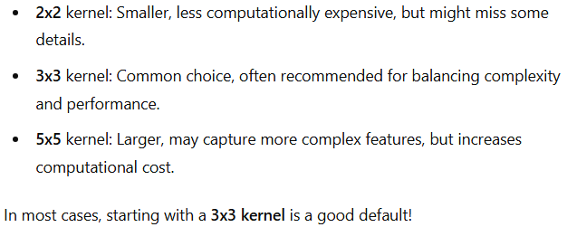
Although the model automatically generate the values of kernel (Weights), we have to define whether we should implement 2 x 2 or 3 x 3 Kernel. In most cases, 3 x 3 kernel is recommended. As:-
Now lets see, how kernel is used with pixel value to generate Convolved Feature, Activation Map, or Feature Map.

Slide 28
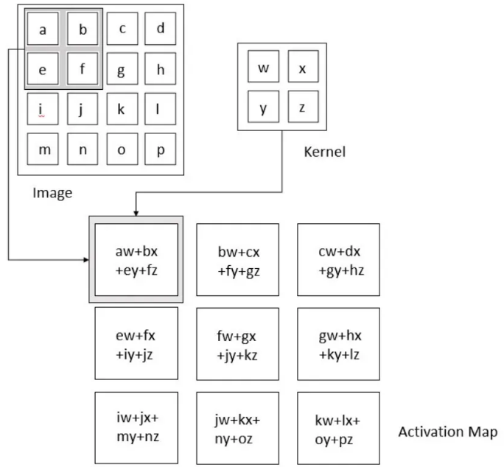
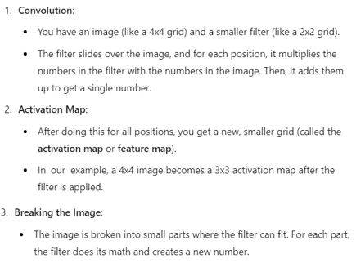
Suppose we have an input image of 4 x 4, and we want to use 2 x2 kernel:-

Slide 29
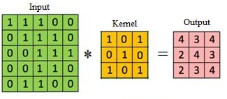


Slide 30
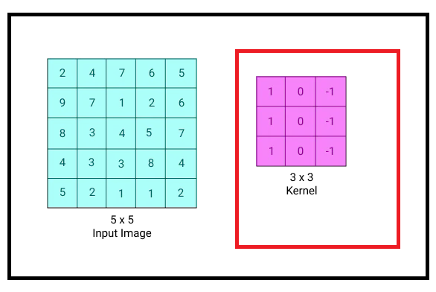
The behavior of the convolutional layer is primarily governed by us with the following main hyperparameters:
1. Kernel Size: The kernel size is the size of the filter window that slides over the image (e.g., 3x3, 5x5). It defines how many pixels the kernel looks at during each step of the convolution operation.

Slide 31
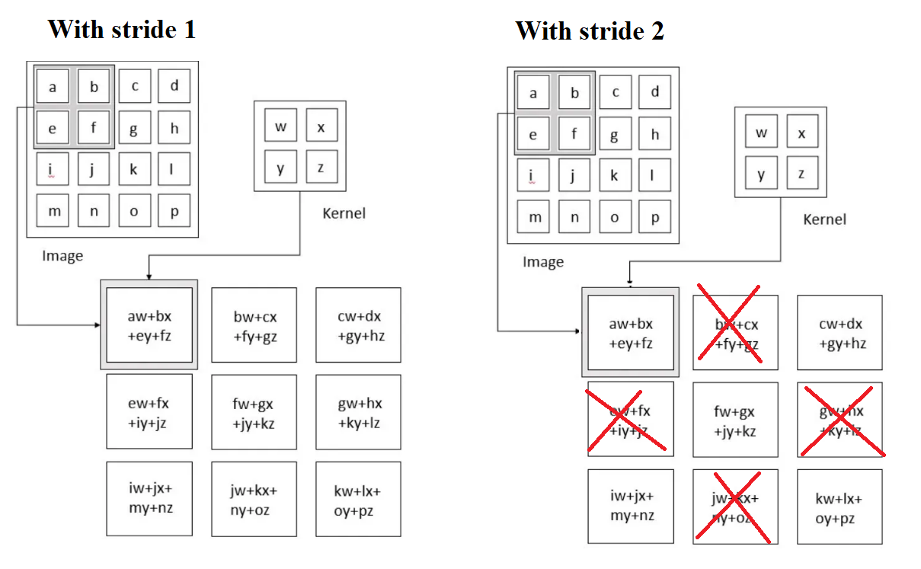
2. Stride: Stride refers to how far the kernel moves with each step.
For example, with a stride of 1, the kernel moves one pixel at a time, covering every pixel in the image.
With a stride of 2, the kernel skips every other pixel, making the output smaller and faster to compute.
Strides of 1 are commonly used to prevent underfitting because the kernel will capture more details.

Slide 32

3. Padding: Padding involves adding extra pixels (usually zeros) around the edges of the image to ensure that the kernel can fully process all parts of the image, including the edges.
Padding helps preserve the dimensions of the output feature map and allows the kernel to cover all areas of the input image.
4. Number of Filters/Depth: If you use 3 filters, the convolutional layer will produce 3 different feature maps, each representing a different characteristic of the image.

Slide 33
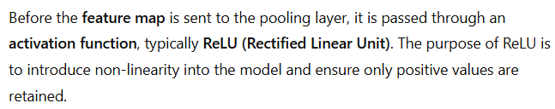
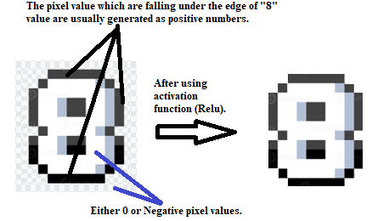

Slide 34
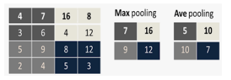
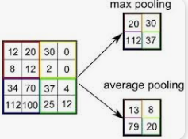
After the convolution layer creates the feature map by breaking the image into smaller parts and performing element-wise multiplication and summation, the resulting feature map is passed to the activation layer (Relu), where, the edge are analyzed (via pixel value with positive number). ReLU sets all negative values in the feature map to zero, introducing non-linearity into the model and enabling it to learn complex patterns.
The resulted image is forwarded to pooling layer.
The goal of the pooling layer is to retain the most relevant information and discard irrelevant details.
In this scenario, the pooling layer processes the pixels of the feature map directly.
The two primary types of pooling are max pooling and average pooling.

Slide 35
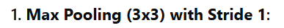

1. Max Pooling:-

Slide 36


Slide 37



Slide 38



Slide 39




Slide 40

Max Pooling (2x2) with Stride 2 in 4 x 4 input:-

Slide 41



Slide 42



Slide 43












Coming to average pooling:-

Slide 44







Slide 45

After seeing both examples of max pooling, here are our observations:-
In most cases, max pooling is chosen because pixels with larger values are considered more relevant. Larger values indicate stronger activations, which are more important for feature detection. Max pooling ignores weak activations and focuses on the strongest features.
In contrast, average pooling computes the average by including even noisy or irrelevant values.

Slide 46



Slide 47


Slide 48

Suppose we want to express the output in probability format; in that case, we can either use sigmoid or softmax. Since we are dealing with one feature, we will use sigmoid as the activation function in the output.
The model will automatically generate a raw value based on the data it has. Using that value, we can substitute it into the activation function to obtain the probability. For example, suppose the raw value is 9:-

Slide 49


Slide 50

Till now, we have seen 2 methods to classify an image by implementing CNN.

Slide 51



Slide 52

Convolution and Correlation
Till now, in the convolution step, we generate either a 3x3 kernel or a 5x5 kernel, with the values automatically generated. Let me explain: to generate the kernel in the convolution method, we either use correlation (where the matrix of the kernel remains as it is) or convolution (where the matrix of the kernel is flipped). Then, we apply the activation function as usual on the activation map. In max situations, we use convolution only. Even if we use correlation, we still use convolution simultaneously.

Slide 53


Slide 54
We primarily use convolution in most cases because of its unique advantages and properties, especially in the context of Convolutional Neural Networks (CNNs).
Here’s why:-
1. Feature Extraction: Convolution flips the kernel, which helps in better capturing patterns like edges, textures, and other local features in an image.
2. Translation Invariance: Convolution ensures that features are detected regardless of their position in the input. Flipping the kernel helps achieve this by analyzing patterns more comprehensively.
3. Efficient Computation: Convolution is computationally efficient as it reduces the dimensions of the input while preserving essential features. This makes it a preferred choice for feature reduction before applying pooling.
4. Edge Detection: Convolution is excellent for edge detection due to the way kernels are flipped and applied. Edges are crucial in understanding the structure of images, and convolution captures this effectively.
5. Compatibility with Activation Functions: After applying convolution, the output is often passed through an activation function like ReLU to introduce non-linearity, which improves the model’s ability to learn complex patterns.
6. Correlation is Less Informative: Correlation does not flip the kernel, so it might miss some spatial relationships that convolution can capture. While correlation can be used, convolution is generally preferred because of its robustness in detecting features.
7. Standard Practice: Most pre-trained models and standard CNN architectures are designed with convolution layers, making it a widely adopted practice in machine learning and computer vision.

Slide 55



Slide 56

Let’s see how we use convolution and correlation together (especially for edge detection):-
Suppose, we have an original pic of “8”:-

Slide 57



Slide 58


Slide 59




Pooling Layer

Slide 60




Slide 61




Slide 62





Slide 63



Slide 64





Slide 65



Slide 66


CNN Architecture
So, till now, we saw how:-

Slide 67



Slide 68


Slide 69


Slide 70


Slide 71

Detection and Segmentation

Slide 72


Slide 73


Slide 74



Slide 75

Image Classification

Slide 76

Image ( or Text) Classification and Hyper-parameter tuning.

Slide 77


Slide 78

Advanced CNNs for computer vision.

Slide 79



Slide 80



Slide 81



Slide 82



